Slide 1
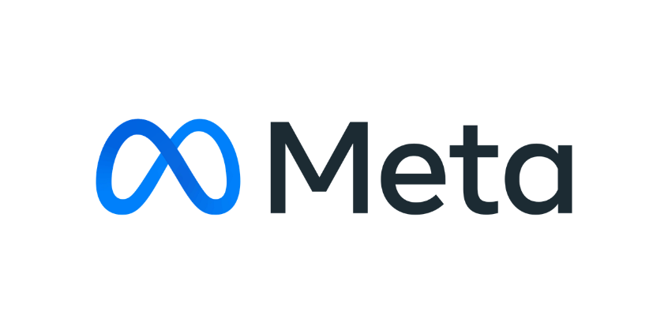
Social Media Analysis Project

Slide 2
Agenda
Problem Statement
Database Schema
Database overview & Description
Database Analysis
Advertisement Strategy
Campaigns and Projections

Slide 3


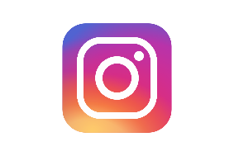

Company Overview
Meta, formerly known as Facebook, is a technology company founded by Mark Zuckerberg in 2004.
It rebranded to Meta in October 2021 to emphasize its focus on building the "metaverse," a virtual reality space where users can interact in a shared, immersive environment.
Meta's ecosystem includes social media platforms like Facebook, Instagram, and WhatsApp, as well as technologies for augmented and virtual reality, such as Oculus.
The company's vision is to create a new digital frontier where people can connect, work, and play in virtual worlds that blend seamlessly with the physical world.

Slide 4
Problem Statement
You are hired as a data analyst at Meta and asked to collaborate with Marketing team. Marketing teams wants to leverage Instagram's user data to develop targeted marketing strategies that will increase user engagement, retention, and acquisition. Provide insights and recommendations to address the following objectives

Slide 5
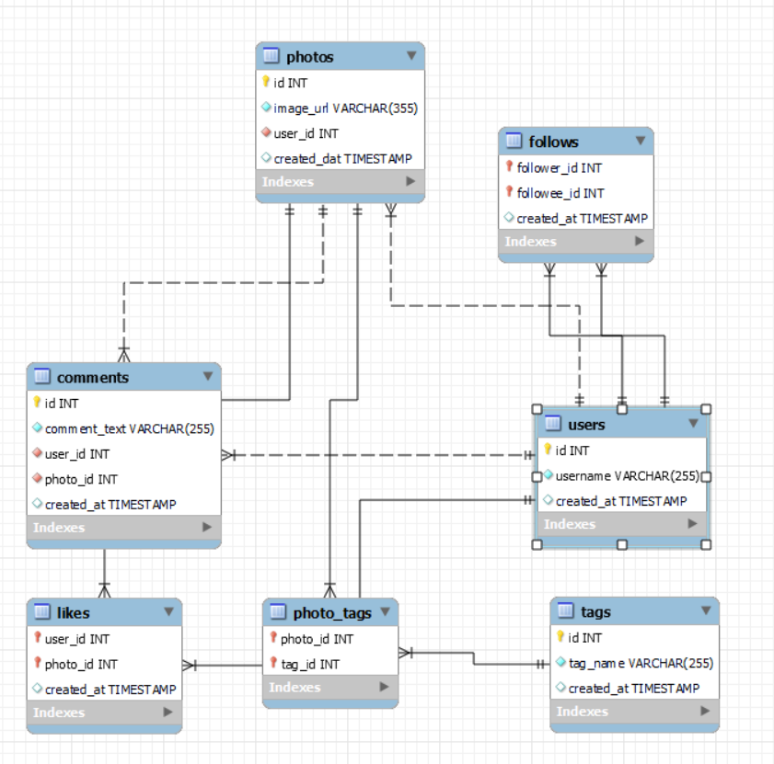
Database Schema

Slide 6
Database overview & Description
Users:
user_id : unique identifier for each user
username : Name of the user
created_at : date of interaction in the form like, photos, tags
Comments:
comments_id : unique identifier for each comment
comment_text : text content of a given comment
user_id : unique identifier for each user
photo_id : unique identifier for each photo
created_at : date of interaction in the form like comments.
Follows:
follower_id : user_id of the follower for a certain user
followee_id : user_id of followee for a certain user
created_at : date of interaction in the form like, photos, tags
Likes:
user_id : unique identifier for each user
photo_id : unique identifier for each photo
created_at : date of interaction in the form likes.
Photos:
photo_id : unique identifier for each photo
image_url : link to the image posted on the platform
user_id : unique identifier for each user
created_at : date of interaction in the form photos.
Tags:
tag_id : unique identifier for each tag
Tag_name : unique identifier for each tag
created_at : date of interaction in the form like tags.
Photo_tags:
photo_id : unique identifier for each photo
tag_id : unique identifier for each tag

Slide 7
Database overview & Description
Total 7 Tables are present in the given dataset.
Total number users are 100.
Total number of posts made so far is 257.
Total number of likes posted by the users on posts is 8782.
Total number of comments on all posts are 7488.
Total number of engagement is calculated by adding total likes and total comments by an user.
Engagement rate is calculated by dividing total engagements by number of posts

Slide 8
Database Analysis
Calculated the total user engagement for every users and then selected some top 10 users on the basis of the engagement rate.
Based on the analysis of the data Top 10 Users have engagement rate from 149 to 166.
The average engagement rate of all the users is 49.22
Only 31 users have more than average engagement rate and 18 users have more than 100
Based on the user engagement _rate the Karley_Bosco has the highest Engagement rate .
For target marketing we will approach these top 10 users personally for collaboration and content creation.

Slide 9
User Segmentation
Based on the user segmentation It is divided into three categories i.e, Less Engaged , Moderately Engaged & Highly Engaged .
In the user segmentation 40.5% users are actively posting and are getting more likes and comments and these are the Highly Engaged users.
45.9% users are who are more active they are on the platform frequently .these are comes under Less Engaged Category.
Remaining 13.5% users are not posting or liking the content and these users are very Less Engaged.
New Users:- 35% of users are joined Recently these users are comes under New Users.
Content Consumers: The 65% users are there on the platform consuming contents but not posting anything are old users.

Slide 10
Content Performance
The difference in average likes across tags is minimal (range: 34.73 to 35.75).
Dreamy is the most engaging hashtag with an average of 35.75 likes per post.
Beauty and Stunning follow closely, showing consistent performance.
Double down on #dreamy and #beauty content to capitalize on higher audience interest.
Analyze top posts using these tags to understand what elements (e.g., filters, captions, visuals) drive engagement.
Focus Areas:
Prioritize content with high-performing tags.
Continuously test underperforming themes with improved formats.
Regularly track hashtag performance to adapt and optimize content strategy.

Slide 11
Content Performance
#smile leads with 59 Engagements, it indicating strong appeal and high user interaction.
Where #beach has 42 Engagements and #party has 39 Engagements, also show strong performance and resonate well with the audience.
These tags drive higher engagement and should be prioritized in future content planning.
Focus Areas:
Focus more on creating content with high-engagement tags like #smile, #beach, and #party.
Analyze what kind of posts under these tags are driving the most interaction (e.g., expressions, travel, celebration).

Slide 12
Advertisement Strategy
Ad campaigns should run on the basis of needs and user segments.
Leveraging User Data for Personalized Ad Content, what type of content they are consuming more show them recommendations.
Notifications should be given on the basis of content users follow and like the most.
Collaborate with the highly engaged users such as Karley_Bosco, Kenneth 64, Erick 5 and create content to encourage others and motivate them to re-engage on the platform.

Slide 13

Campaigns and Projections
Run Email Campaigns to Re-Engage Inactive Users:
Craft personalized, behavior-based emails to reconnect with potential users who have dropped off.
Target Users Based on Browsing Categories & Content:
Use content consumption patterns across platforms to deliver relevant and timely messages.
Send Personalized & Catchy Notifications:
Tailor push notifications to user preferences; ensure they are interactive, funny, and non-intrusive.
Collaborate with High-Engagement Users (Influencers):
Identify and reward collaborators who consistently drive engagement and platform reach.
Segment Target Audiences for Precision Marketing:
Group users by interest, behavior, or demographics to serve more relevant campaigns.
Use Humor and Creativity in Notifications:
Make alerts and nudges entertaining to increase click-through and reduce opt-outs
Invest More in Weak-Performing Ad Areas with Potential:
Reallocate ad spend strategically to improve ROI in segments with growth potential.

Slide 14
Thank you!

